Slide 1

Loan Eligibility Prediction Using Machine Learning Algorithms
CSE438 Project Presentation
Presented By :
Arko Mazhar | 18201118
Sumaiya Mehjabeen | 19101116
Khairun Nisa | 19101376
Razit Kabir | 22241108

Slide 2

TABLE OF CONTENTS
INTRODUCTION
Data
Collection
Data Preprocessing
Exploratory Data Analysis
Model Building
Prediction Accuracy
Best Accuracy
Future Scope of Improvement
Conclusion

Slide 3

Introduction to Loan Default
Problem Statement:
A default occurs when a borrower stops making the required payments on a debt.
According to central bank data, the country's state-owned banks have default loans of Tk60,502 crore, which is 23.04% of total loans. (Source: Bangladesh Bank)
To solve this problem,we look into a data science approach to predict and understand the applicant’s profile to minimize the risk of future loan defaults.

Slide 4
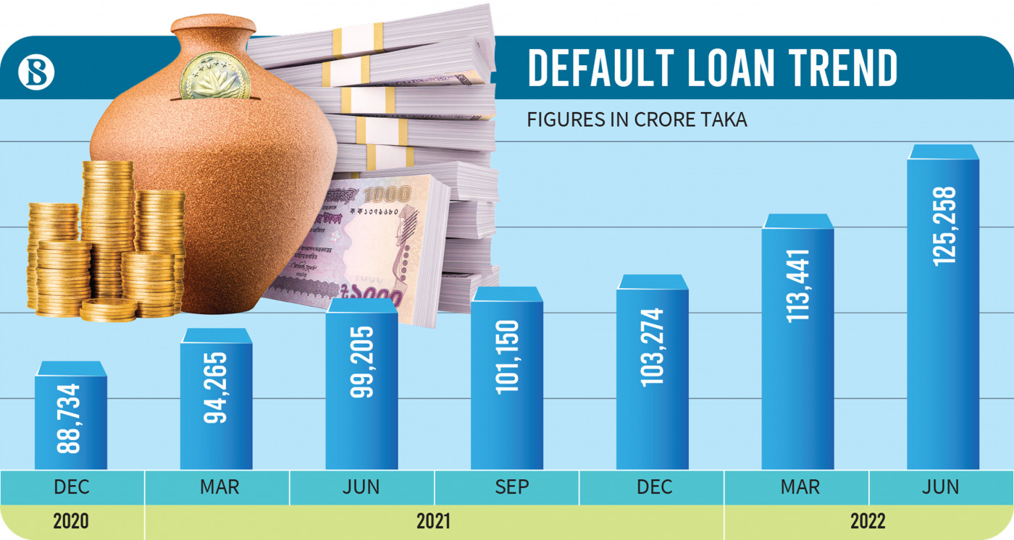
Source: The Business Standard

Slide 5
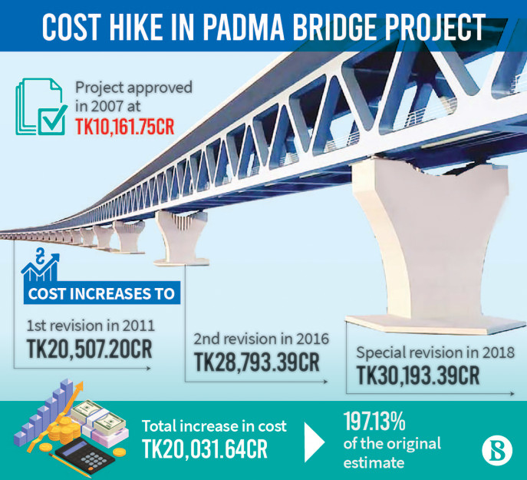
Source: The Business Standard

Slide 6
Data Collection
Source:Singapore Private Bank & Lending Club Loan Dataset
Merged two datasets

Slide 7
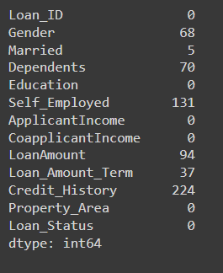
Data Preprocessing
Data Cleaning
Removal of unwanted observations such as Hobby,Personal Interest.
Detecting null values and replacing them with Mean/Mode (Which shows better accuracy after trial and errors.
Managing Unwanted outliers
Figure:Total Null Values

Slide 8
Exploratory Data Analysis
Visualizing the whole dataset using different analysis
Univariate Analysis
Bi-Variate Analysis
Multivariate Analysis

Slide 9
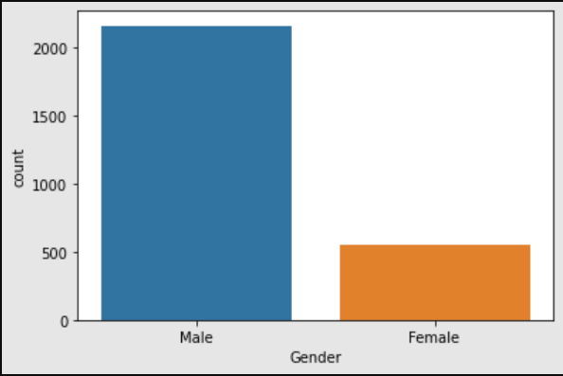
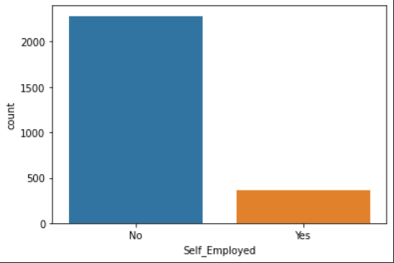
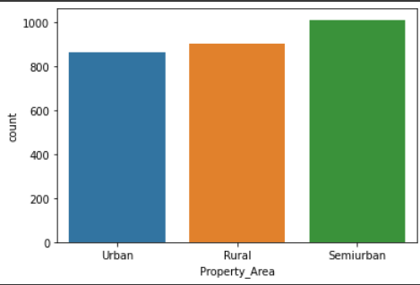
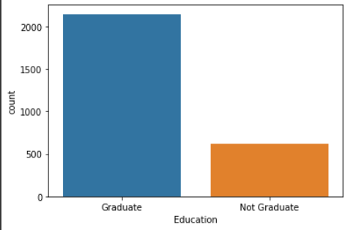
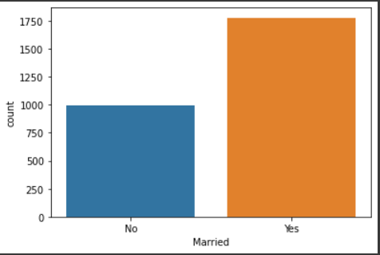
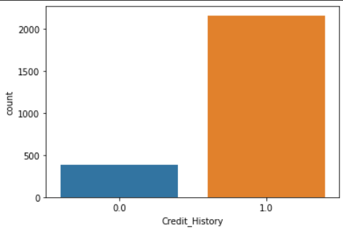
Exploratory Data Analysis
Univariate Analysis: Gender,Self_Employed,Property Area,Education etc

Slide 10
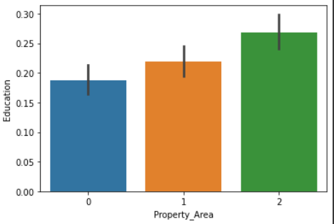
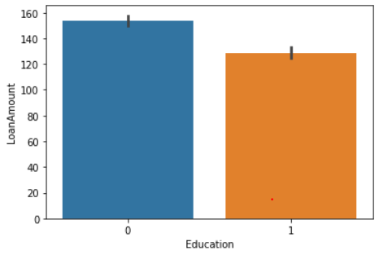
Exploratory Data Analysis
Bivariate Analysis:

Slide 11
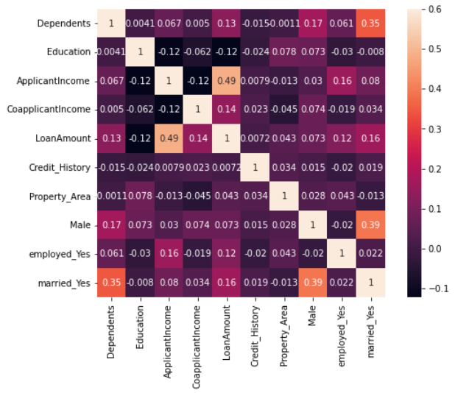
Exploratory Data Analysis
Multivariate Analysis using Correlation Matrix:

Slide 12

Model Building
Random Forest
Logistic Regression
K-Nearest
Neighbors
Gradient Boosting
Classifiers
Naive Bayes
Support Vector Machine

Slide 13
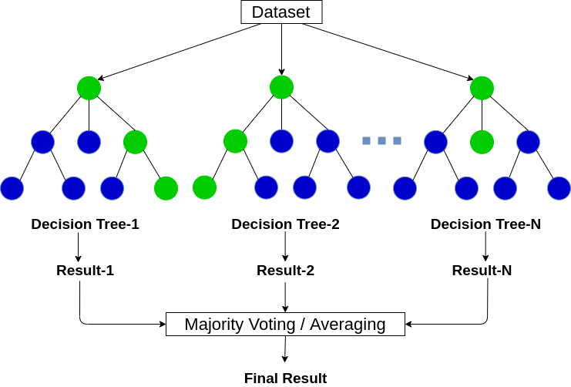
Random Forest
It builds decision trees on different samples and takes their majority vote
It can be used for both classification and regression problems
Accuracy and variable importance information is provided with result.
Random Forest classifier Accuracy - 93.40%
Fig. Random Forest Classifier Flowchart

Slide 14
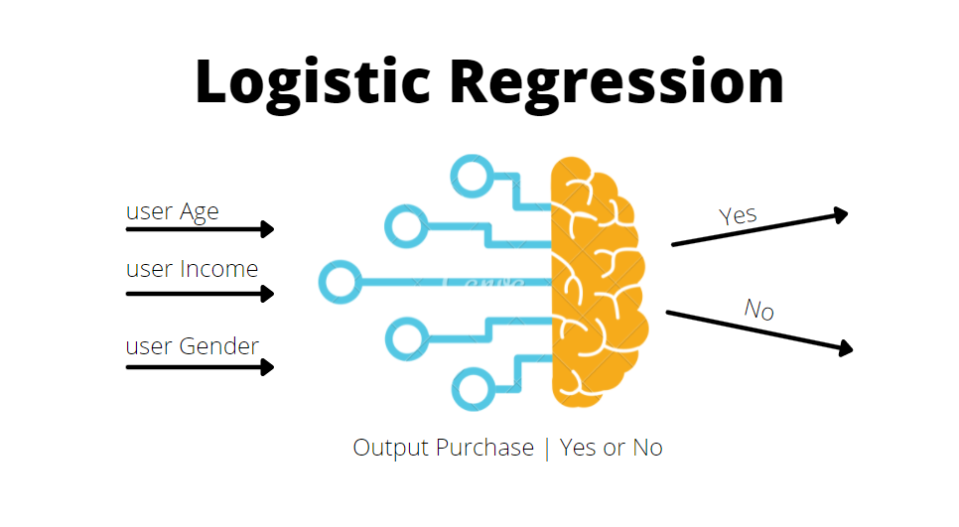
Logistic Regression
Based on linear regression to evaluate the output and to minimize the error
It is used to predict a binary outcome (1 / 0, Yes / No, True / False) given a set of independent variables.
It analyzes relationships between variables.
Fig. Logistic Regression Overview
Logistic Regression Accuracy - 78.75%

Slide 15
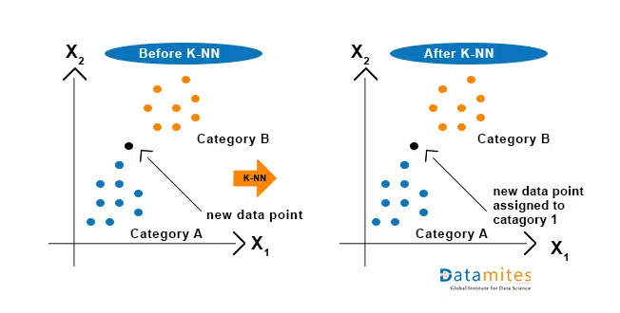
K-Nearest Neighbors
K-NN algorithm assumes the similarity between the new case/data and available cases
It stores all the available data and classifies a new data point based
on the similarity.
K-NN can be used to predict if a person is fit for loan approval or not.
Fig. Before and after overview of KNN
KNN Accuracy - 86.43%

Slide 16
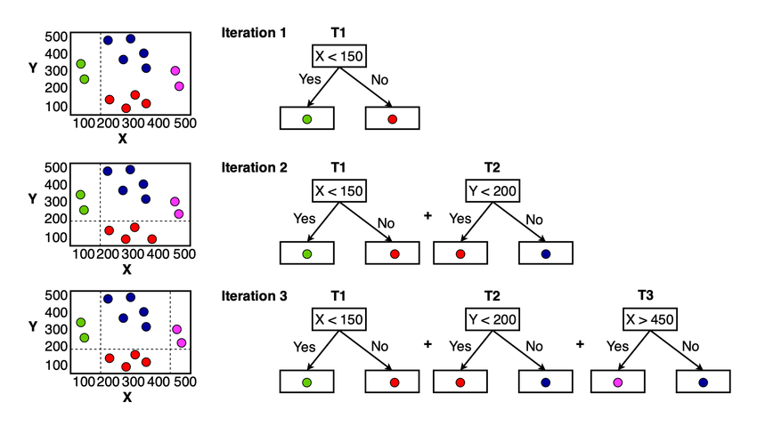
Gradient Boosting Classifier
It combine many weak learning models together to create a strong predictive model.
Gradient Boosting is a tree-based algorithm, which sits under the supervised branch of Machine Learning
It particularly use for large and complex datasets.
Fig. Diagram of Gradient Boosting
Gradient Boosting Accuracy - 85.59%

Slide 17
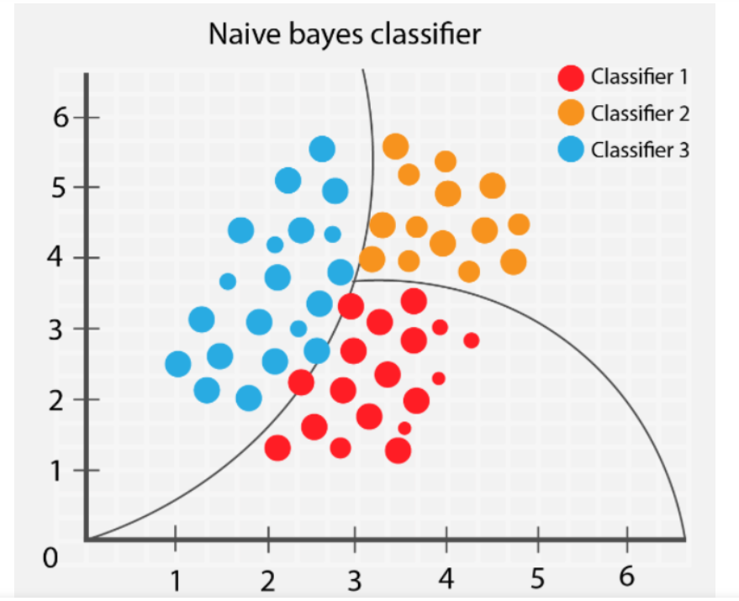
Naive Bayes
Naive Bayes algorithm is a supervised learning algorithm, which is based on Bayes theorem and used for solving classification problems.
It is mainly used in text classification that includes a high-dimensional training dataset.
It is used to make real-time predictions.
Fig. Diagram of Naive Bayes
Naive Bayes Accuracy - 76.83%

Slide 18
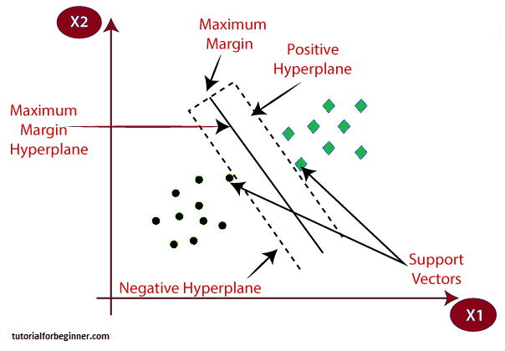
SVM(Support Vector Machine) Algorithm
SVM is a supervised machine learning algorithm used for both classification and regression.
SVM algorithm can be used for Face detection, image classification, text categorization
In machine learning it is used for Classification problems.
SVM Accuracy - 69.75%
Fig. Diagram of SVM

Slide 19
Best Result
Highest Accuracy-
Random Forest : 93.40%
Why?
Trees may predict the correct output, while others may not.
The greater number of trees in the forest leads to higher accuracy and prevents the problem of overfitting.

Slide 20
Future Scope of Improvement
AdaBoost, XGBoost algorithm can be implemented.
Feature engineering such as manipulation, addition, deletion can be completed in a better way.
Large dataset implementation could’ve been done.

Slide 21
CONCLUSION
Data collection, Exploratory Data Analysis, Data Preprocessing, Model Building, and Model Testing are the analytical processes involved in building this system.
We have examined 6 types of models and reviewed in greater depth

Slide 22


Thank You !!
Do you have any questions??

